Slide 1
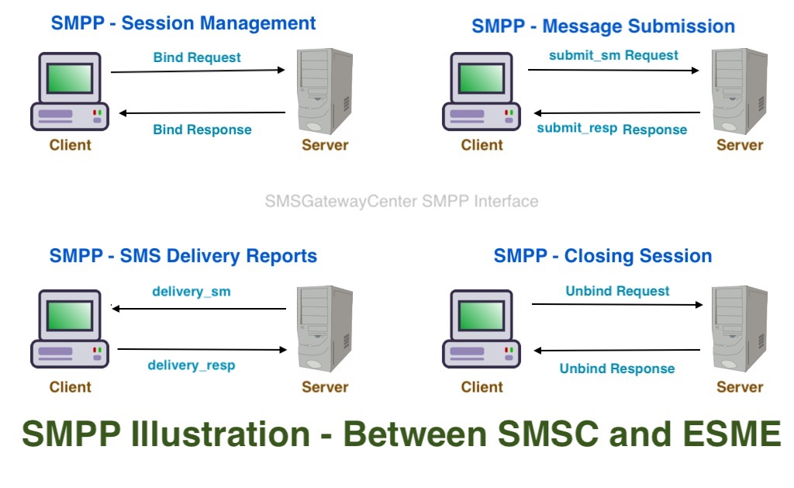




SMPP2SMPP: Comprehensive SMPP Solutions for SMS Messaging
A Bonrix Software Systems Product
SMPP Client
SMPP Gateway
HTTP API
MySQL

Slide 2








About SMPP2SMPP
A product of Bonrix Software Systems, a leading IT solutions provider since 2001
Based in Ahmedabad, Gujarat, India
Specializes in SMPP protocol solutions for SMS messaging
Provides comprehensive SMS gateway solutions for businesses
Compatible with almost all SMS Gateways supporting SMPP protocol
Supports high-volume SMS messaging with reliable delivery
Used for marketing, campaigns and corporate communication

Slide 3

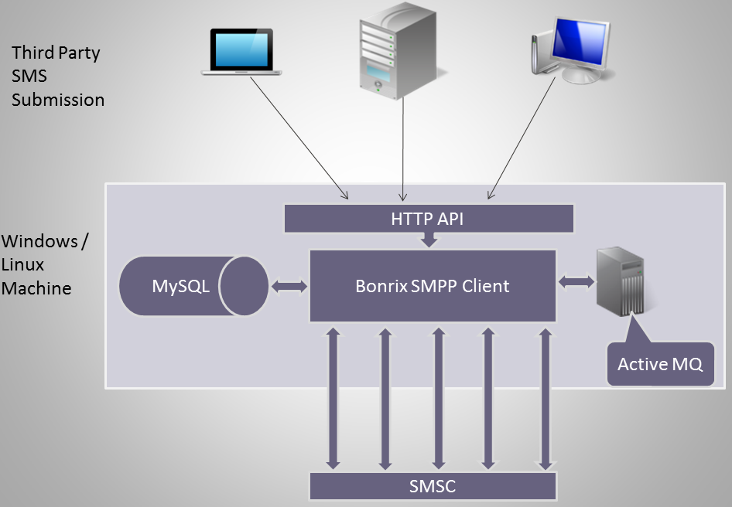




Product Offerings
Bonrix SMPP Client
Java Desktop Application for point-to-point messaging to SMSC gateway
Bonrix SMPP Gateway
J2EE web application for SMS gateway services
Bonrix SMS Server 4 SMPP
Desktop software for group/bulk SMS through Internet
HTTP API Integration
Accept SMS submission from third-party applications
Required Components
Java Runtime Environment, MySQL Server, SMPP Client & Gateway

Slide 4



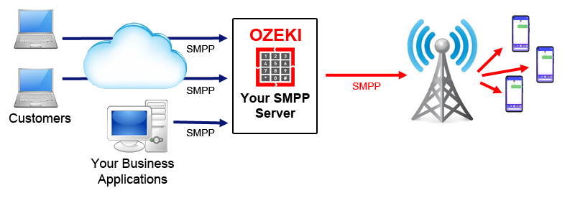




Key Features
SMPPv3.3 Protocol
Multi-Threaded
Compatible with modern SMPP standards
Unlimited connections with SMSC Gateway
High-Speed Messaging
HTTP API Support
Unbelievable speed for bulk SMS delivery
Accept SMS from third-party apps
Multiple File Formats
Database Integration
Upload CSV/Excel/text for bulk messaging
Stores reports in MySQL database
Open API
TCP-IP Connectivity
Sample source code for customization
Direct connection options for clients

Slide 5

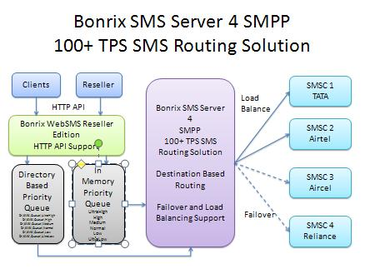



Technical Requirements
Java Runtime Environment
MySQL Server
Free database server required to run SMPP software
Mandatory software to operate Bonrix SMPP applications
Bonrix SMPP Client
Bonrix SMPP Gateway
Java Desktop Application for point-to-point messaging
Complete package with all necessary dependent software
System Requirements
Network Requirements
Standard desktop/server hardware specifications
Internet connectivity for SMSC gateway communication
Compatibility
Works with almost all SMS Gateways supporting SMPP

Slide 6








Benefits of SMPP Solutions
High Throughput
Reliable Delivery
Send thousands of messages per second
Maximum throughput with dependable delivery
Cost-Effective
Scalable
Affordable SMS gateway solutions
Solutions that grow with your business
Versatile Applications
Easy Integration
Marketing, campaigns & corporate communication
Simple integration via HTTP API
Customizable
Multi-Carrier Support
Open API for tailored solutions
Send SMS via multiple carriers on one platform

Slide 7





Contact Us
Address
A-801, Samudra Complex Near Classik Gold Hotel Off C.G.Road, Ahmedabad Gujarat - 380009, India
Email
info@bonrix.net bonrix@gmail.com
Phone
Websites
smpp2smpp.com bonrix.net bonrix.in bonrix.co.in
+91-9426045500 +91-9429045500
Landline
+91-79-26426364

